Slide 1


Noida Institute of Engineering and Technology, Greater Noida
Artificial Intelligence & Machine Learning
Unit: 02
Machine Learning & Feature Engineering
Course Details
B-Tech 3rd Sem. Online & Offline
Mohini Chakarverti
Assistant Professor
Department of CSE(AIML)
1

Slide 2

Faculty Introduction
Name | Mohini Chakarverti
Qualification | Ph.D.(Pursuing)
Designation | Assistant Professor
Department | CSE-AIML
NIET Experience | 3 Years
Subject Taught | Introduction to AI and ML

Slide 3
Evaluation Scheme
 | Sl. No. | Subject Codes |  | Subject | Periods |  |  | Evaluation Schemes |  |  |  | End Sem |  | Total | Credit | Category Type
 |  |  |  |  | L | T | P | CT | TA | TOTAL | PS | TE | PE
 | 1 |  |  | Statistics & Probability | 3 | 1 | 0 | 30 | 20 | 50 |  | 100 |  | 150 | 4 | BSC
 | 2 |  |  | Discrete Structures | 3 | 1 | 0 | 30 | 20 | 50 |  | 100 |  | 150 | 4 | BSC
 | 3 |  |  | Artificial Intelligence & Machine Learning | 3 | 0 | 0 | 30 | 20 | 50 |  | 100 |  | 150 | 3 | PCC
 | 4 |  |  | Data Structures & Algorithm-I | 3 | 0 | 0 | 30 | 20 | 50 |  | 100 |  | 150 | 3 | PCC
 | 5 |  |  | Logic Design and Computer Architecture | 3 | 0 | 0 | 30 | 20 | 50 |  | 100 |  | 150 | 3 | PCC
 | 6 |  |  | Object Oriented Techniques using Java | 0 | 0 | 6 |  |  |  | 50 |  | 100 | 150 | 3 | PCC
 | 7 |  |  | Artificial Intelligence & Machine Learning Lab | 0 | 0 | 2 |  |  |  | 50 |  | 50 | 100 | 1 | PCC
 | 8 |  |  | Data Structures & Algorithm-I Lab | 0 | 0 | 4 |  |  |  | 25 |  | 25 | 50 | 2 | PCC
 | 9 |  |  | Internship Assessment- I | 0 | 0 | 2 |  |  |  | 50 |  |  | 50 | 1 | PW
 | 10 |  |  | AI & Cyber Ethics / Environmental Science *(Non Crédit) | 2 | 0 | 0 | 30 | 20 | 50 |  | 50 |  | 100 | 0 | NC
 |  |  |  | MOOCs (For B.Tech. Hons. Degree)
 |  |  |  | TOTAL |  |  |  |  |  |  |  |  |  | 1100 | 24

Slide 4
Syllabus
UNIT-1 Introduction to AI and Machine Learning
Introduction to AI and Intelligent agent, Different Approaches of AI,
Problem Solving by searching Techniques:
Uninformed search- BFS, DFS, Iterative deepening, Bidirectional search,
Informed search- Iterative deepening, Bidirectional search, Heuristic search, Greedy Best First Search, A* search, Local Search Algorithms-Hill Climbing and Simulated Annealing Adversarial Search-
Game Playing- minimax, alpha-beta pruning,
constraint satisfaction problems

Slide 5
Syllabus
UNIT-2 Machine Learning & Feature Engineering
Introduction to Machine Learning, Types of Machine Learning,
Feature Engineering: Features and their types, handing missing data,
Dealing with categorical features,
Working with features: Feature Scaling, Feature selection,
Feature Extraction: Principal Component Analysis (PCA) algorithm

Slide 6
Syllabus
UNIT-3 Supervised Learning
Regression & Classification: Types of regression (Univariate, Multivariate, Polynomial), Mean Square Error, R square error,
Logistic Regression
Regularization: Bias and Variance, Overfitting and Underfitting, L1 and L2 Regularization, Regularized Linear Regression
Decision Trees (ID3, C4.5, CART), Confusion matrix, k-folds cross-validation,
K Nearest Neighbour, Support vector machine

Slide 7
Syllabus
UNIT-4 Unsupervised Machine Learning
Introduction to clustering, Types of clustering:
K-means clustering, K-mode, K-medoid, hierarchical clustering, single-linkage, multiple linkage, AGNES and DIANA algorithms, Gaussian mixture models
density based clustering, DBSCAN

Slide 8
Syllabus
UNIT-5 Ensemble & Reinforcement Learning
Probabilistic learning
:Bayesian Learning, Naive Bayes Classifier, Bayesian belief networks
Ensembles Learning
Random Forest, Gradient Boosting, XGBoost.
Reinforcement Learning:
Introduction to reinforcement learning, models of reinforcement learning: Markov decision process, Q-learning.

Slide 9
Branch Wise Applications
Maps and Navigation
Computer Vision
Facial Detection and Recognition
Text Editors or Autocorrect
Search and Recommendation Algorithms
Chatbots
Digital Assistants
Social Media
E-Payments
Digital Advertising

Slide 10
Course Objectives
The objective of this course is to systematically formulate and design machine learning problems for various applications, apply artificial intelligence algorithms and problem-solving methods to real-world scenarios, optimize the resulting models, and report on their expected accuracy.

Slide 11
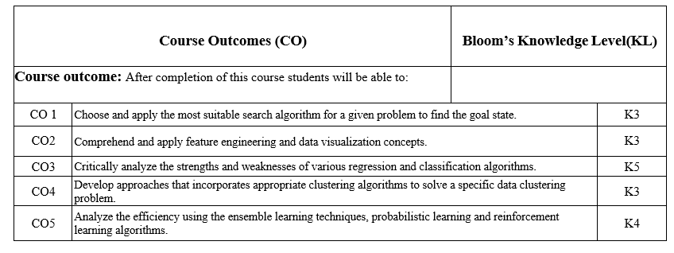
Course Outcomes

Slide 12
Program Outcomes
Engineering Graduates will be able to:
PO1 : Engineering Knowledge
PO2 : Problem Analysis
PO3 : Design/Development of solutions
PO4 : Conduct Investigations of complex problems
PO5 : Modern tool usage
PO6 : The engineer and society

Slide 13
Program Outcomes
Engineering Graduates will be able to:
PO7 : Environment and sustainability
PO8 : Ethics
PO9 : Individual and teamwork
PO10 : Communication
PO11 : Project management and finance
PO12 : Life-long learning

Slide 14
Program Specific Outcomes
On successful completion of graduation degree the Computer Science &
Engineering graduates will be able to:
PSO1: | Design and develop the Hardware and Software systems.
PSO2: | Understand the interdisciplinary computing techniques and an ability to apply them in the design of advanced computing.
PSO3: | Understand the programming methodology, software development paradigms, design and analysis of Algorithms, Operating Systems, Digital Logic Design, Theory of Computation, Discrete Mathematics, Compiler Design, etc.
PSO4: | To integrate & manage the various phases/components of software development projects of society.

Slide 15
Program Educational Objectives
Program Educational Objectives (PEOs) | PEOs Description
PEOs | To have an excellent scientific and engineering breadth so as to comprehend, analyze, design and provide sustainable solutions for real-life problems using state-of-the-art technologies.
PEOs | To have a successful career in industries, to pursue higher studies or to support entrepreneurial endeavors and to face the global challenges.
PEOs | To have an effective communication skills, professional attitude, ethical values and a desire to learn specific knowledge in emerging trends, technologies for research, innovation and product development and contribution to society.
PEOs | To have life-long learning for up-skilling and re-skilling for successful professional career as engineer, scientist, entrepreneur and bureaucrat for betterment of society.

Slide 16
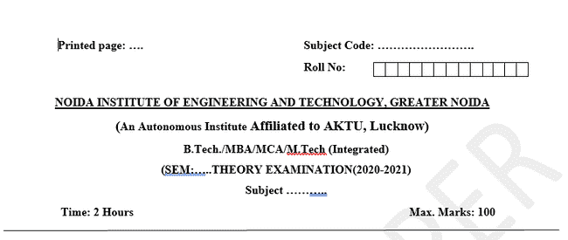
Question Paper Template

Slide 17
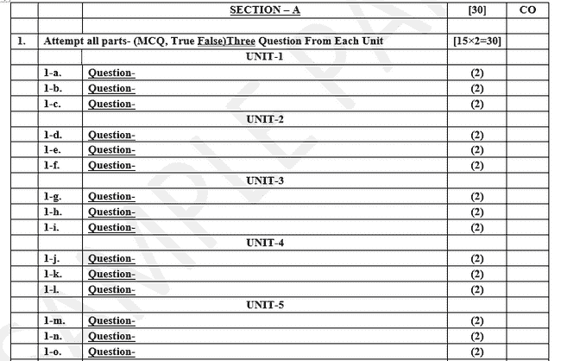
Question Paper Template

Slide 18
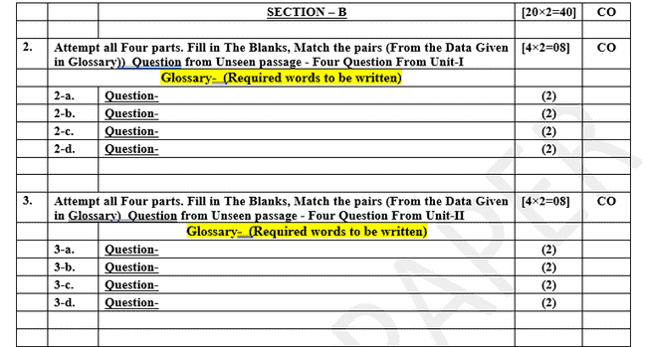
Question Paper Template

Slide 19
Question Paper Template

Slide 20
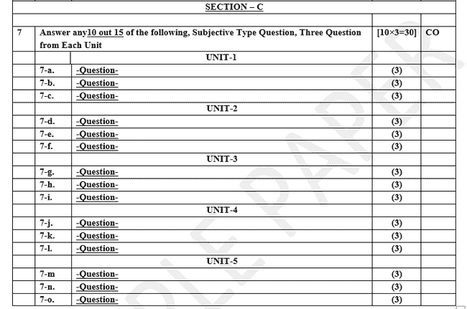
Question Paper Template

Slide 21
PREREQUISITE
Prerequisites:
Statistics.
Linear Algebra.
Calculus.
Probability.
Programming Languages.

Slide 22
Unit Content
Introduction to Machine Learning,
Types of Machine Learning,
Feature Engineering: Features and their types,
handing missing data,
Dealing with categorical features,
Working with features: Feature Scaling,
Feature selection,
Feature Extraction: Principal Component Analysis (PCA) algorithm

Slide 23

Introduction to Machine Learning
Top minds in machine learning predict where AI is going in 2021 and Beyond
AI is no longer poised to change the world someday; it’s changing the world now.

Slide 24

Introduction
Soumith Chintala
Director, principal engineer, and creator of PyTorch
“I actually don’t think we’ve had a groundbreaking thing … since Transformer, basically. We had ConvNets in 2012 that reached prime time, and Transformer in 2017 or something. That’s my personal opinion,”
Chintala also believes the evolution of machine learning frameworks like PyTorch and Google’s TensorFlow — the overwhelming favorites among ML practitioners today — have changed how researchers explore ideas and do their jobs.

Slide 25
Introduction
Soumith Chintala
Director, principal engineer, and creator of PyTorch
Depending on how you gauge it, PyTorch is the most popular machine learning framework in the world today.
A derivative of the Torch open source framework introduced in 2002, PyTorch became available in 2015 and is growing steadily in extensions and libraries.

Slide 26

Introduction
Celeste Kidd
Developmental psychologist at the
University of California, Berkeley
Celeste Kidd is director of Kidd Lab at the University of California, Berkeley, where she and her team explore how kids learn.
“Human babies don’t get tagged data sets, yet they manage just fine, and it’s important for us to understand how that happens,” she said.
Last month, Kidd delivered the opening keynote address at the Neural Information Processing Systems (NeurIPS) conference, the largest annual AI research conference in the world. Her talk focused on how human brains hold onto stubborn beliefs, attention systems, and Bayesian statistics.

Slide 27

Introduction
Jeff Dean
Google AI chief
Dean has led Google AI for nearly two years now, but he’s been at Google for two decades and is the architect of many of the company’s early search and distributed network algorithms and an early member of Google Brain.
Dean spoke with VentureBeat last month at NeurIPS, where he delivered talks on machine learning for ASIC semiconductor design and ways the AI community can address climate change, which he said is the most important issue of our time. In his talk about climate change, Dean discussed the idea that AI can strive to become a zero-carbon industry and that AI can be used to help change human behavior.

Slide 28

Introduction
Anima Anandkumar
Nvidia machine learning research director
Anandkumar sees numerous challenges for the AI community in 2020, like the need to create models made especially for specific industries in tandem with domain experts. Policymakers, individuals, and the AI community will also need to grapple with issues of representation and the challenge of ensuring data sets used to train models account for different groups of people.

Slide 29

Introduction
Dario Gil
IBM Research director
Gil heads a group of researchers actively advising the White House and enterprises around the world. He believes major leaps forward in 2019 include progress around generative models and the increasing quality with which plausible language can be generated.

Slide 30
Introduction
What industry is looking ?
Advances in natural language models were a major story of 2019 as Transformers fueled great leaps forward. Look for more variations of BERT and Transformer-based models in 2021.
The AI industry should look for ways to value model outputs beyond accuracy.
Methods like semi-supervised learning, a neural symbolic approach to machine learning, and subfields like multitask and multimodal learning may progress in the year ahead.
Ethical challenges related to biometric data like speech recordings will likely continue to be controversial.
Compilers and approaches like quantization may grow in popularity for machine learning frameworks like PyTorch and TensorFlow as ways to optimize model performance.

Slide 31
Introduction

Slide 32
Introduction

Slide 33
Introduction

Slide 34
Introduction

Slide 35
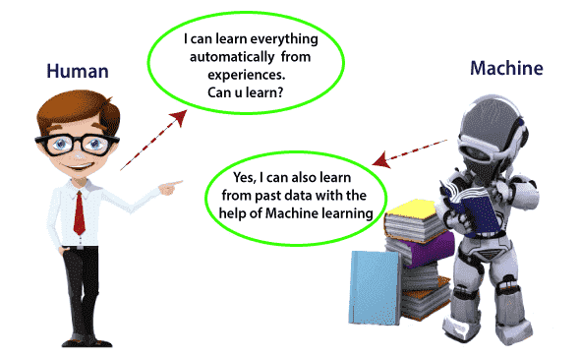
Introduction to ML(CO2)
What is Machine Learning

Slide 36
Introduction

Slide 37
Introduction

Slide 38
Introduction

Slide 39
Introduction

Slide 40
Introduction

Slide 41
Introduction

Slide 42
Introduction

Slide 43
Introduction

Slide 44
Introduction

Slide 45
Introduction

Slide 46
Introduction

Slide 47
Introduction

Slide 48
Introduction

Slide 49
Introduction

Slide 50
Introduction

Slide 51
Introduction

Slide 52
Introduction

Slide 53
Introduction

Slide 54
Introduction

Slide 55
Introduction

Slide 56
Introduction

Slide 57
Introduction

Slide 58
Introduction

Slide 59
Introduction

Slide 60
Introduction

Slide 61
Introduction

Slide 62
Introduction

Slide 63
Introduction

Slide 64
Introduction

Slide 65
Introduction

Slide 66
What is a Feature?
Generally, all machine learning algorithms take input data to generate the output.
The input data remains in a tabular form consisting of rows (instances or observations) and columns (variable or attributes), and these attributes are often known as features. For example, an image is an instance in computer vision, but a line in the image could be the feature.
Similarly, in NLP, a document can be an observation, and the word count could be the feature. So, we can say a feature is an attribute that impacts a problem or is useful for the problem.
The features you use influence more than everything else then the result. No algorithm alone, to my knowledge, can supplement the information gain given by correct feature engineering.

Slide 67
Feature Engineering
● Feature engineering is the pre-processing step of machine learning, which extracts features from raw data.
● It helps to represent an underlying problem to predictive models in a better way, which as a result, improve the accuracy of the model for unseen data.
● The predictive model contains predictor variables and an outcome variable, and while the feature engineering process selects the most useful predictor variables for the model

Slide 68
What is its importance and why it is used?
Feature engineering in machine learning improves the model's performance. Below are some points that explain the need for feature engineering:
● Better features mean flexibility. In machine learning, we always try to choose the optimal model to get good results. However, sometimes after choosing the wrong model, still, we can get better predictions, and this is because of better features. The flexibility in features will enable you to select the less complex models. Because less complex models are faster to run, easier to understand and maintain, which is always desirable.
● Better features mean simpler models. If we input the well-engineered features to our model, then even after selecting the wrong parameters (Not much optimal), we can have good outcomes. After feature engineering, it is not necessary to do hard for picking the right model with the most optimized parameters. If we have good features, we can better represent the complete data and use it to best characterize the given problem.
● Better features mean better results. As already discussed, in machine learning, as data we will provide will get the same output. So, to obtain better results, we must need to use better features.

Slide 69
Main processes of Feature Engineering
The steps of feature engineering may vary as per different data scientists and ML engineers. However, there are some common steps that are involved in most machine learning algorithms, and these steps are as follows:
● Data Preparation: The first step is data preparation. In this step, raw data acquired from different resources are prepared to make it in a suitable format so that it can be used in the ML model. The data preparation may contain cleaning of data, delivery, data augmentation, fusion, ingestion, or loading.
● Exploratory Analysis: Exploratory analysis or Exploratory data analysis (EDA) is an important step of features engineering, which is mainly used by data scientists. This step involves analysis, investing data set, and summarization of the main characteristics of data. Different data visualization techniques are used to better understand the manipulation of data sources, to find the most appropriate statistical technique for data analysis, and to select the best features for the data.
● Benchmark: Benchmarking is a process of setting a standard baseline for accuracy to compare all the variables from this baseline. The benchmarking process is used to improve the predictability of the model and reduce the error rate.

Slide 70
Feature Engineering
Feature engineering is a crucial step in the data preprocessing phase of machine learning and data analysis. It involves creating new features from raw data to improve the performance of a model

Slide 71
Feature and their type
Features (or attributes) are individual measurable properties or characteristics of a phenomenon being observed. They can be classified into several types:
Numerical Features:
Continuous: Can take any value within a range (e.g., height, weight, temperature).
Discrete: Can take only integer values (e.g., number of children, count of items).
Categorical Features:
Nominal: Categories without any intrinsic order (e.g., color, gender).
Ordinal: Categories with a meaningful order but no consistent difference between levels (e.g., rating scale, education level).

Slide 72
Datetime Features:
Features related to dates and times (e.g., timestamp, day of the week).
Text Features:
Features derived from textual data (e.g., word count, sentiment score).
Feature and their type

Slide 73
Handling Missing Data
Missing data can significantly impact the performance of a
machine learning model. Common methods for handling missing
data include:
Removal:
Remove rows or columns with missing values.
Suitable when the amount of missing data is small.

Slide 74
Handling Missing Data
Imputation:
Mean/Median/Mode Imputation: Replace missing values with the mean,
median, or mode of the feature.
Forward/Backward Fill: Use the previous or next value to fill missing data
in time series.
Predictive Imputation: Use a machine learning model to predict
and fill missing values.
Flagging:
Create a new binary feature to indicate whether the value was missing.

Slide 75
Dealing with Categorical Features
Handling categorical features involves converting them
into a numerical format that can be used by machine learning
algorithms. Common techniques include:
Label Encoding:
Assign a unique integer to each category.
Useful for ordinal features but can introduce unintended ordinal
relationships in nominal features.

Slide 76
Dealing with Categorical Features
One-Hot Encoding:
Create a new binary feature for each category.
Helps to avoid ordinal relationships in nominal features
but can increase dimensionality.
Target Encoding:
Replace categories with the mean of the target variable for each category.
Useful for high-cardinality features.
Frequency Encoding:
Replace categories with the frequency of each category. Helps to handle
high-cardinality features and captures information about category frequency.

Slide 77
What is Feature Scaling?
Feature scaling is a preprocessing technique that transforms feature values to a similar scale, ensuring all features contribute equally to the model.
It’s essential for datasets with features of varying ranges, units, or magnitudes.
Common techniques include standardization, normalization, and min-max scaling.
This process improves model performance, convergence, and prevents bias from features with larger values.

Slide 78
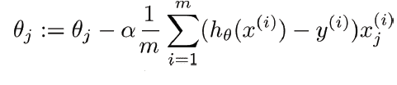
Why Should we Use Feature Scaling?
some machine learning algorithms are sensitive to feature scaling, while others are virtually invariant.
Let’s explore these in more depth:
Gradient Descent Based Algorithms
Machine learning algorithms like linear regression, logistic regression, neural network, PCA (principal
component analysis), etc.,
that use gradient descent as an optimization technique require data to be scaled.
Take a look at the formula for gradient descent below:
The presence of feature value X in the formula will affect the step size of the gradient descent.
The difference in the ranges of features will cause different step sizes for each feature.
To ensure that the gradient descent moves smoothly towards the minima and that the steps for gradient
descent are updated at the same rate for all the features,
we scale the data before feeding it to the model.

Slide 79
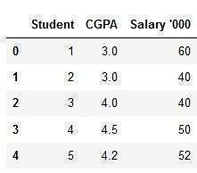
Feature and their type
2. Distance-Based Algorithms
Distance algorithms like KNN, K-means clustering, and SVM(support vector machines) are most affected by the range
of features.
This is because, behind the scenes, they are using distances between data points to determine
their similarity.
For example, let’s say we have data containing high school CGPA scores of students (ranging from 0 to 5)
and their future incomes (in thousands Rupees):

Slide 80
Feature and their type
3. Tree-Based Algorithms
Tree-based algorithms, on the other hand, are fairly insensitive to the scale of the features.
Think about it, a decision tree only splits a node based on a single feature.
The decision tree splits a node on a feature that increases the homogeneity of the node.
Other features do not influence this split on a feature.

Slide 81
Feature selection
Feature selection is a process that chooses a subset of features from the original features
so that the
feature space is optimally reduced according to a certain criterion.
Feature selection is a critical step in the feature construction process.
In text categorization problems, some words simply do not appear very often.
Perhaps the word “groovy” appears in exactly one training document, which is positive.
It’s a dangerous endeavor because it’s hard to tell with just one training example if it is
really correlated with the positive class or is it just noise.

Slide 82
Feature selection
There are three general classes of feature selection algorithms:
Filter methods, wrapper methods and embedded methods.
The role of feature selection in machine learning is,
1. To reduce the dimensionality of feature space.
2. To speed up a learning algorithm.
3. To improve the predictive accuracy of a classification algorithm.
4. To improve the comprehensibility of the learning results.

Slide 83
Features Selection Algorithms are as follows:
1. Instance based approaches: There is no explicit procedure for feature subset generation.
Many small data samples are sampled from the data. Features are weighted according to their roles in
differentiating instances of different classes for a data sample. Features with higher weights can be selected.
2. Nondeterministic approaches: Genetic algorithms and simulated annealing are also used in feature selection.
3. Exhaustive complete approaches: Branch and Bound evaluates estimated accuracy and ABB checks an
inconsistency measure that is monotonic. Both start with a full feature set until the preset bound cannot be maintained.
While building a machine learning model for real-life dataset, we come across a lot of features in the dataset
and not all these features are important every time. Adding unnecessary features while training the model leads
us to reduce the overall accuracy of the model, increase the complexity of the model and decrease the generalization
capability of the model and makes the model biased. Even the saying “Sometimes less is better” goes as well for the
machine learning model. Hence, feature selection is one of the important steps while building a machine learning model.
Its goal is to find the best possible set of features for building a machine learning model.

Slide 84
Feature Extraction
Feature extraction is the process of identifying and selecting the most important
information or characteristics from a data set.
It’s like distilling the essential elements, helping to simplify and highlight the
key aspects while filtering out less significant details.
It’s a way of focusing on what truly matters in the data.
Feature extraction is important because it makes complicated information simpler.
In things like computer learning, it helps find the most crucial patterns or details,
making computers better at predicting or deciding things by focusing on what matters
in the data.

Slide 85
Principal Component Analysis(PCA)
Principal Component Analysis (PCA) technique was introduced by the mathematician Karl Pearson in 1901.
It works on the condition that while the data in a higher dimensional space is mapped to data in a
lower dimension space, the variance of the data in the lower dimensional space should be maximum.
Principal Component Analysis (PCA) is a statistical procedure that uses an orthogonal transformation that
converts a set of correlated variables to a set of uncorrelated variables.PCA is the most widely used tool in exploratory
data analysis and in machine learning for predictive models. Moreover,
Principal Component Analysis (PCA) is an unsupervised learning algorithm technique used to examine the
interrelations among a set of variables. It is also known as a general factor analysis where regression determines a
line of best fit.

Slide 86
Principal Component Analysis(PCA)
The main goal of Principal Component Analysis (PCA) is:
- to reduce the dimensionality of a dataset while preserving
the most important patterns or relationships between the variables without any prior knowledge of the target variables.
-Principal Component Analysis (PCA) is used to reduce the dimensionality of a data set by finding a new set of variables, smaller than the original set of variables, retaining most of the sample’s information, and useful for the regression and classification of data.

Slide 87
Principal Component Analysis(PCA)
Principal Component Analysis (PCA) is a technique for dimensionality reduction that
identifies a set of orthogonal axes, called principal components, that capture the maximum
variance in the data.
The principal components are linear combinations of the original variables in
the dataset and are ordered in decreasing order of importance.
The total variance captured by all the principal components is equal to the total variance in the
original dataset.
The first principal component captures the most variation in the data, but the second
principal component captures the maximum variance that is orthogonal to the first principal
component, and so on.

Slide 88
Principal Component Analysis(PCA)
Principal Component Analysis can be used for a variety of purposes, including data visualization, feature selection, and data compression.
In data visualization, PCA can be used to plot high-dimensional data in two or three dimensions, making it easier to interpret. In feature selection, PCA can be used to identify the most important variables in a dataset.
In data compression, PCA can be used to reduce the size of a dataset without losing important information.
In Principal Component Analysis, it is assumed that the information is carried in the variance of the features, that is, the higher the variation in a feature, the more information that features carries.

Slide 89
QUIZ
Agents can be grouped into five classes based on their degree of perceived intelligence and i
Machine learning is a subset of ______ that allows systems to learn from data and improve performance without being explicitly programmed.
a) Data Science
b) Artificial Intelligence
c) Deep Learning
d) Computer Vision
Which type of machine learning works with labeled data?
a) Supervised Learning
b) Unsupervised Learning
c) Reinforcement Learning
d) Semi-Supervised Learning

Slide 90
QUIZ
In unsupervised learning, which of the following tasks groups similar data points together?
a) Classification
b) Clustering
c) Regression
d) Dimensionality Reduction
What is the primary purpose of feature engineering?
a) To collect more data
b) To improve model interpretability and performance
c) To train the machine learning model faster
d) To reduce the size of the dataset
Which of the following is NOT a method to handle missing data?
a) Dropping rows with missing values
b) Filling missing values with mean or median
c) Encoding missing data using one-hot encoding
d) Predicting missing values using other features

Slide 91
QUIZ
What is the main difference between label encoding and one-hot encoding?
a) Label encoding works only on numerical data, while one-hot encoding works on categorical data.
b) Label encoding assigns integers to categories, while one-hot encoding creates binary columns for each category.
c) Label encoding is always better than one-hot encoding.
d) One-hot encoding is used only for ordinal data.
What does feature scaling aim to achieve?
a) Make features more independent of each other
b) Reduce the size of the dataset
c) Bring features to a comparable scale
d) Improve feature correlation

Slide 92
QUIZ
Agents can be grouped into five classes based on their degree of perceived intelligence and i
What is the first step in performing PCA?
a) Calculate the covariance matrix of the data
b) Normalize the data
c) Determine the eigenvectors and eigenvalues
d) Select the top principal components
Which of the following is an example of supervised learning?
a) Identifying customer segments in marketing
b) Predicting house prices based on historical data
c) Reducing the number of features in a dataset
d) Finding hidden patterns in unlabeled data

Slide 93
ASSIGNMENT
Define machine learning and explain the primary differences between supervised, unsupervised, and reinforcement learning. Provide examples for each.
Describe a real-world application of supervised learning. How would you structure the dataset for this problem?
What are the key challenges in using unsupervised learning? Give an example of where it can be effectively applied.
Explain semi-supervised learning. What type of datasets is this approach best suited for, and why?
What is feature scaling? Compare and contrast standardization and normalization. When would you use each method?
Write a Python code snippet to apply Min-Max scaling to a numerical feature in a dataset using the sklearn library.
What is feature selection, and why is it important? Discuss two methods of feature selection and their advantages.
Explain the process of Principal Component Analysis (PCA) and its applications in dimensionality reduction.

Slide 94
GLOSSARY QUESTIONS
Agents can be grouped into five classes based on their degree of perceived intelligence and i
Machine Learning is a subset of ______ that allows computers to learn from data without being explicitly programmed.
In ______ learning, the model is trained on labeled data with input-output pairs.
______ learning involves finding patterns in unlabeled data.
______ learning combines a small amount of labeled data with a large amount of unlabeled data.
In ______ learning, an agent learns by interacting with the environment and receiving rewards or penalties.
______ features are numerical values, such as age or income.

Slide 95
GLOSSARY QUESTIONS
Features that represent categories, like gender or country, are called ______ features.​
______ features are ordered categories, like education levels or customer ratings.​
Missing data in a dataset can be handled using methods like ______, ______, or ______.​
Encoding categories as binary columns, where each column represents a single category, is called ______ encoding.​
​
Feature ______ ensures that all features have comparable scales, which improves the performance of many ML models.​
Rescaling features to a range between 0 and 1 is known as ______.​
Reducing the number of features while retaining the most relevant ones is called ______.​
______ is a dimensionality reduction technique that transforms data into uncorrelated components while retaining maximum variance.​
A high correlation between two features in a dataset can lead to ______, which PCA can help to address.
Agents can be grouped into five classes based on their degree of perceived intelligence and i

